Slide 1
GRAMS Telemetry

Slide 2
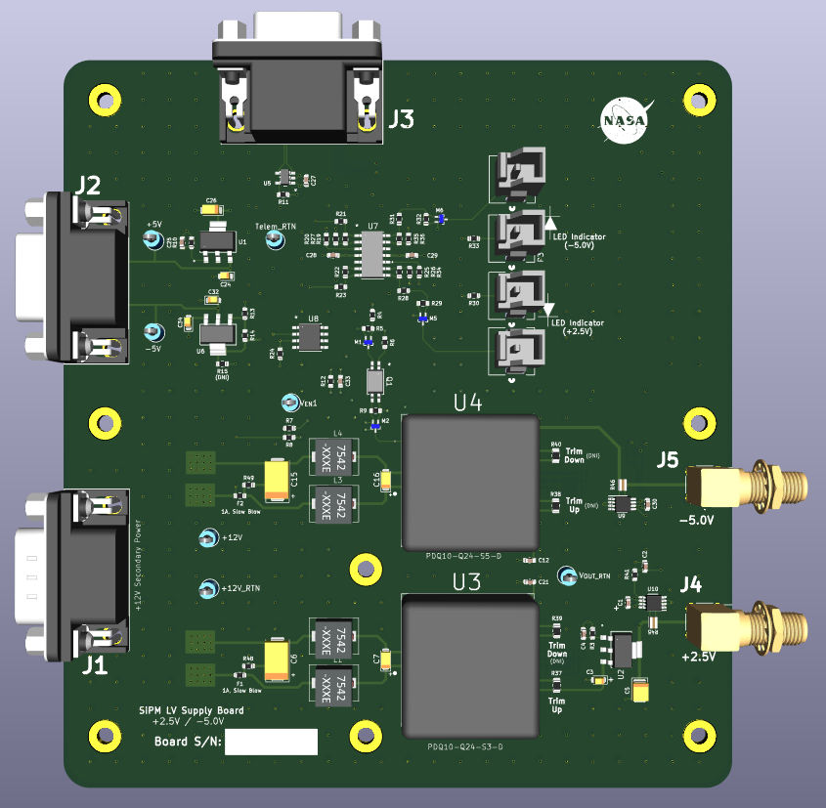
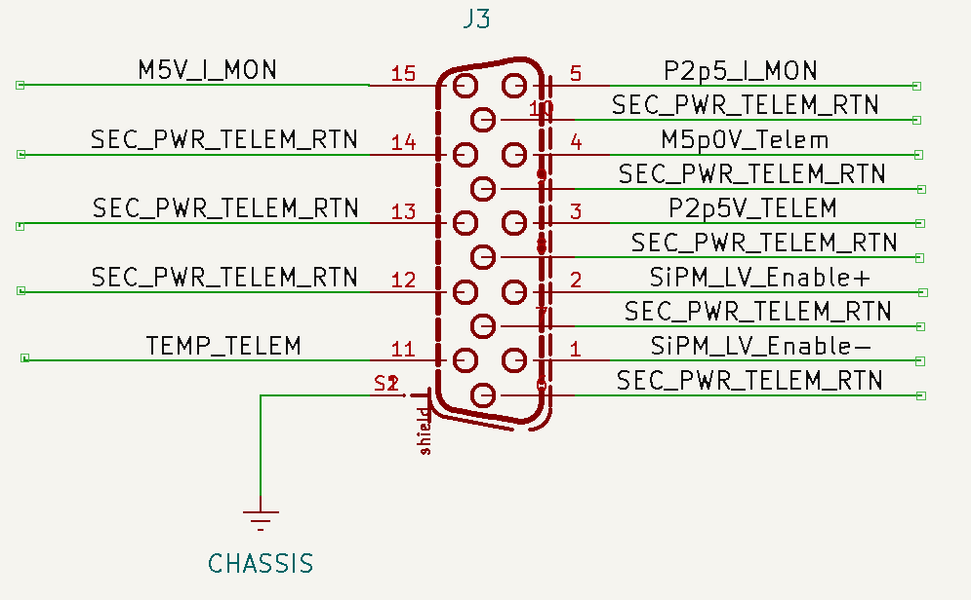
COLD TPC (Low Voltage PDU) +2.5 / -5V

Slide 3
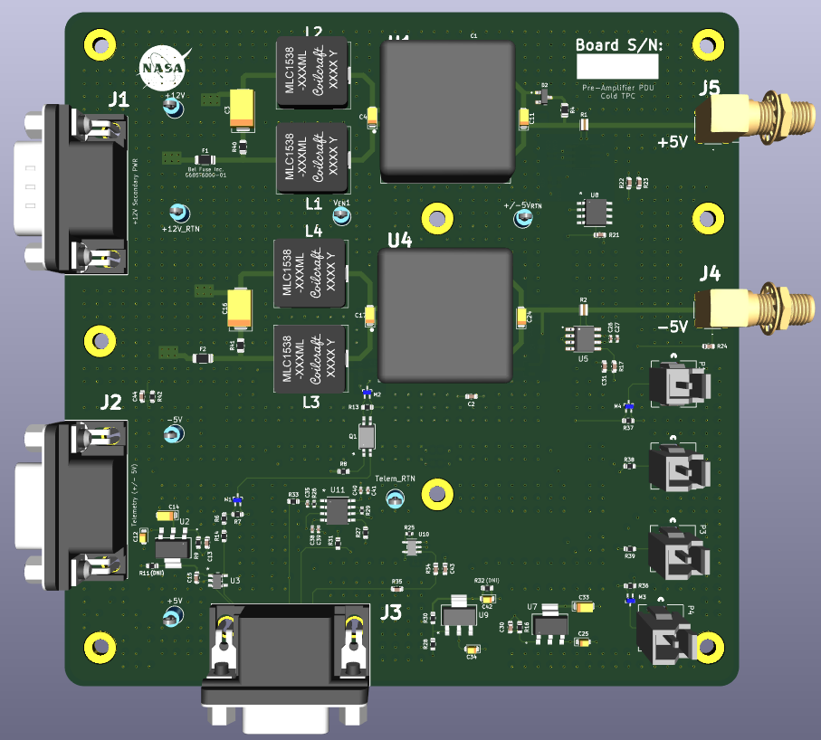
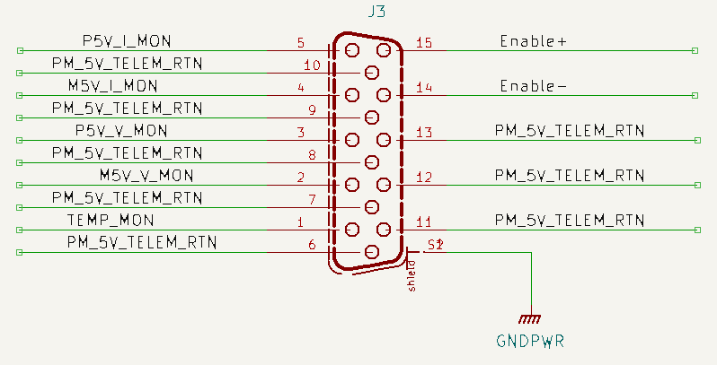
COLD TPC (Pre-Amplifier PDU) +/- 5V

Slide 4
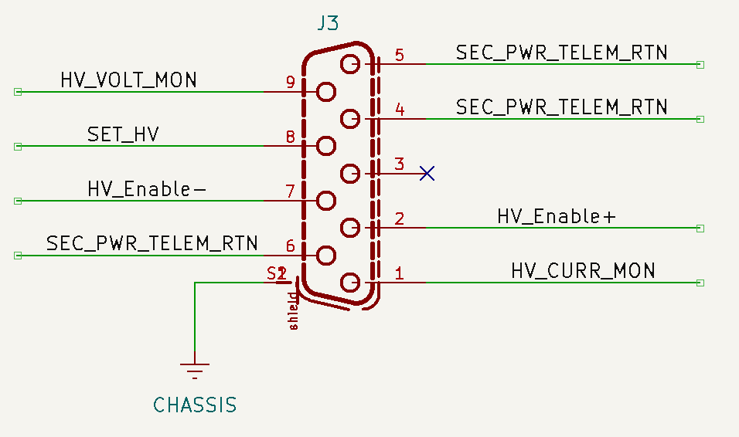
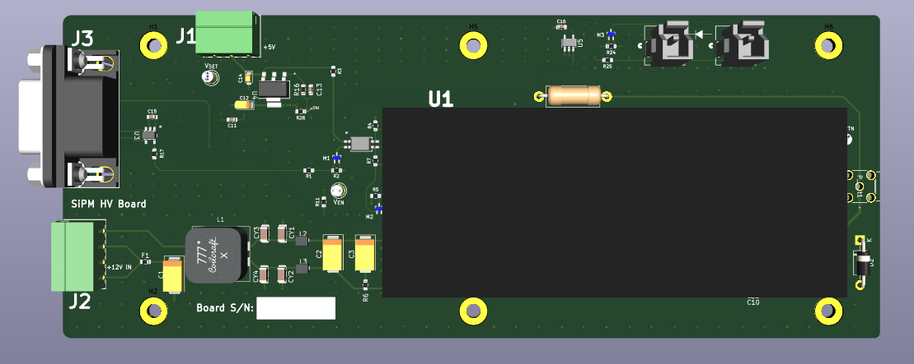
COLD TPC (HV Bias) 0 to +60V

Slide 5
TPC Cold PDU Box Block Diagram

Slide 6
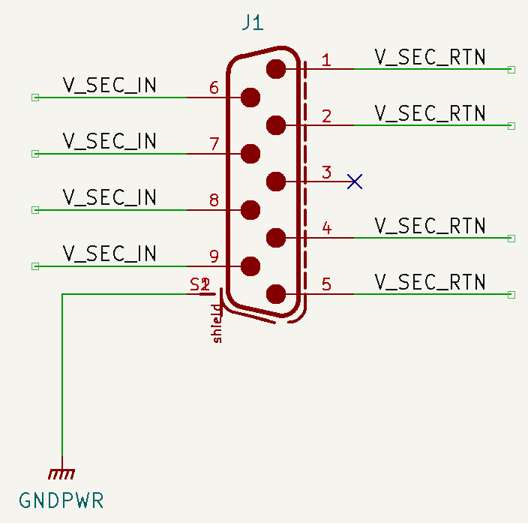
Telemetry I/O
44-Pin D-Sub (Telemetry for SiPM HV Boards)
SiPM HV Bias 1
NOTES:
All of the 9-Pin Secondary Power connectors have the same configuration. All of these will be receiving power from the main PDU Board.
Secondary / Telemetry PWR
SiPM HV Bias 2
Telemetry Power Board for SiPM HV Boards
9-Pin D-Sub Secondary Power
SiPM HV Bias 3
9-Pin D-Sub Secondary Power
SiPM HV Bias 6
Cold TPC (+2.5V / -5V)
Secondary PWR
Telemetry Power Board for COLD TPC LV Boards
9-Pin D-Sub Secondary Power
Telemetry PWR
Cold TPC (Pre-Amplifier PDU)
Telemetry PWR
9-Pin D-Sub Secondary Power
Secondary PWR
37-Pin D-Sub (Telemetry for Cold TPC LV Boards)

